Slide 1
Node.js PACKAGES
By Mykhailo Torskyi

Slide 2
Packages
A package is a file or directory that is described by a package.json file. A package must contain a package.json file in order to be published to the npm registry

Slide 3
A module is any file or directory in the node_modules directory that can be loaded by the Node.js require() function.
To be loaded by the Node.js require() function, a module must be one of the following:
A folder with a package.json file containing a "main" field.
A folder with an index.js file in it.
A JavaScript file.

Slide 4
NPM
Relied upon by more than 11 million developers worldwide, npm is committed to making JavaScript development elegant, productive, and safe. The free npm Registry has become the center of JavaScript code sharing, and with more than one million packages, the largest software registry in the world. Our other tools and services take the Registry, and the work you do around it, to the next level.

Slide 5
Public packages
As an npm user or Org member, you can create and publish public packages that anyone can download and use in their own projects.
Unscoped public packages exist in the global public registry namespace and can be referenced in a package.json file with the package name alone: package-name.
Scoped public packages belong to a user or Org and must be preceded by the user or Org name when included as a dependency in a package.json file:
@username/package-name
@org-name/package-name

Slide 6
Private packages
With npm private packages, you can use the npm registry to host code that is only visible to you and chosen collaborators, allowing you to manage and use private code alongside public code in your projects.
Private packages always have a scope, and scoped packages are private by default.
User-scoped private packages can only be accessed by you and collaborators to whom you have granted read or read/write access. For more information, see “Adding collaborators to private packages owned by a user account”.
Org-scoped private packages can only be accessed by teams that have been granted read or read/write access. For more information, see “Managing team access to Org packages”.

Slide 7
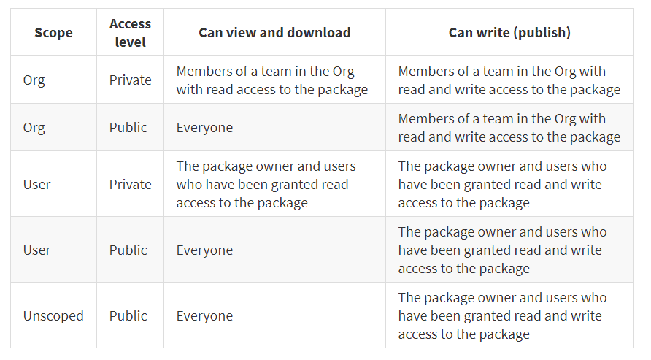
Public registry

Slide 8
NPM commands
npm i Alias for npm install
npm install Install everything in package.json
npm install --production Install everything in package.json, except devDependecies
npm install lodash Install a package
npm install --save-dev lodash Install as devDependency
npm install --save-exact lodash Install with exact

Slide 9
npm list Lists the installed versions of all dependencies in this software
npm list -g --depth 0 Lists the installed versions of all globally installed packages
npm view Lists the latest versions of all dependencies in this software
npm outdated Lists only the dependencies in this software which are outdated

Slide 10


